Slide 1
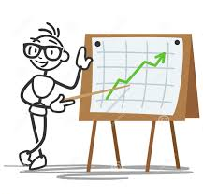
DESCRIPTIVE STATISTICS
Topic 4
Contents:
4.1 Introduction
4.2 Organizing data
4.3 Measurement of central tendency and dispersion

Slide 2
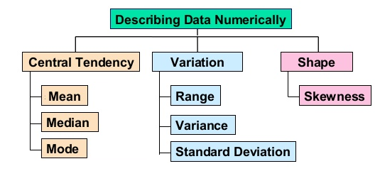
SUBTOPICS:
4.3.1 Measures of Central Tendency
4.3.2 Measures of Dispersion

Slide 3
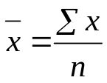
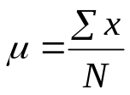
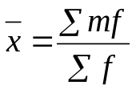
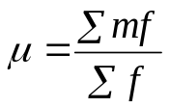

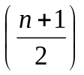
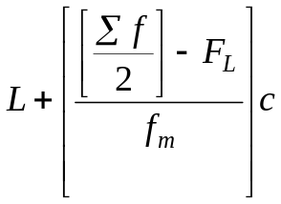
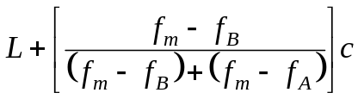
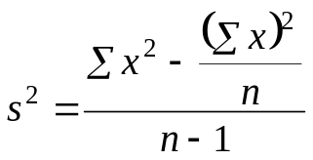
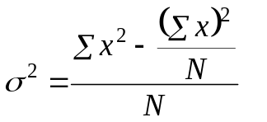
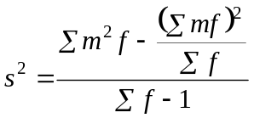
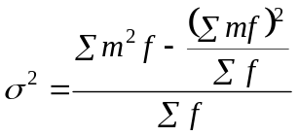


Measures Summary |  | Raw Data
 |  | Ungrouped Data |  | Grouped Data
 |  | Sample | Population | Sample | Population
Measures of Central Tendency | Mean
 | Median | Rank data in order Position of Median = th Find Median |  | Position of Median = th Median class Median =
 | Mode | Highest number of occurrences Find Mode |  | Mode class (highest frequency) Mode =
Measures of Dispersion | Variance
 | Standard Deviation

Slide 4
4.3.1 MEASURES OF CENTRAL TENDENCY
A measure of central tendency is a measure that tells us where the middle of a bunch of data lies.
There are three common measures of the central tendency, which are:
Mean
Mode
Median

Slide 5
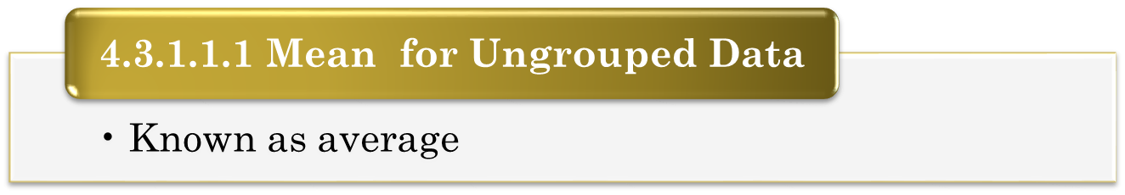
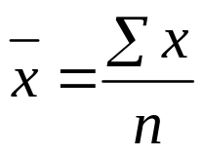
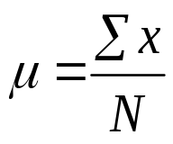
4.3.1 MEASURES OF CENTRAL TENDENCY
For Sample Data:
For Population Data:
The value of μ is constant but varies from sample to sample
Outliers or extreme values are very small or very large relative to the majority of the values in a data set.
Mean | = | Sum of all values
 |  | Number of values

Slide 6

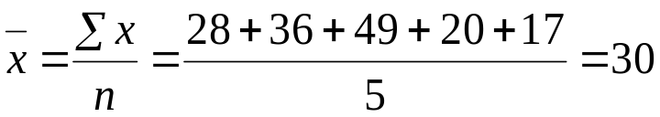
Example 1
Find the mean of the following sample of numbers:
28 36 49 20 17
Solution:
Number of values,
Thus, the mean,

Slide 7
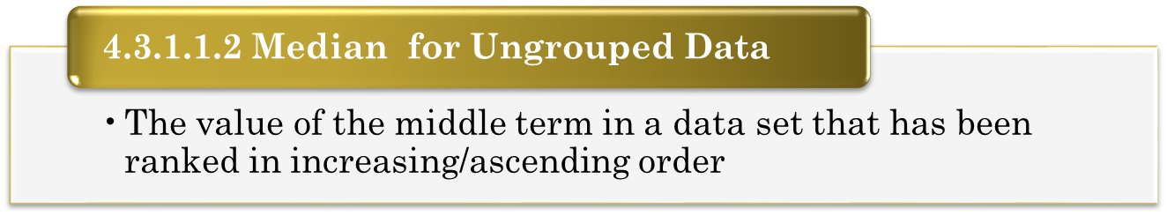
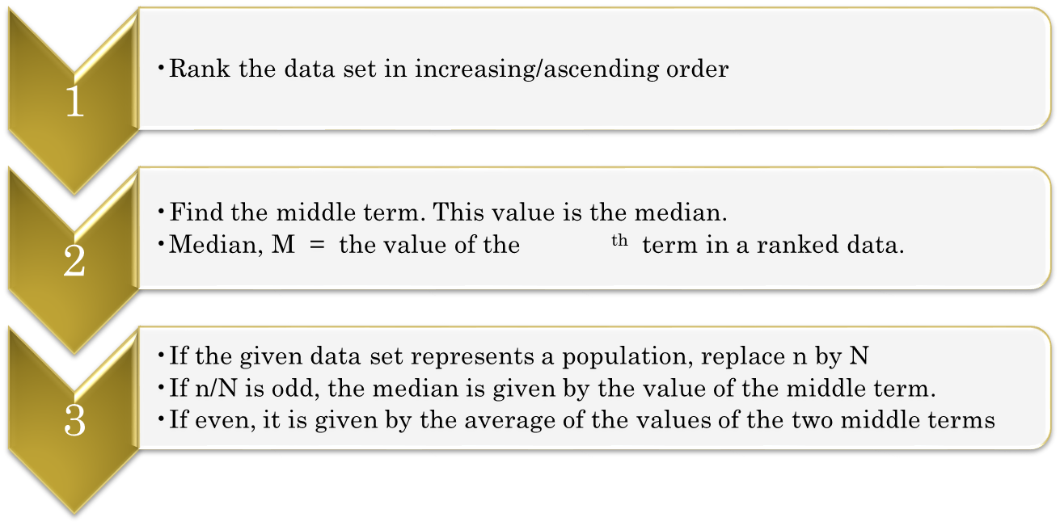

4.3.1 MEASURES OF CENTRAL TENDENCY
Steps:

Slide 8
Example 2
Calculate the median of the following data:
250 300 180 240 290
Solution:
The data must be ranked in increasing order:
180 240 250 290 300
Thus, the median is 250

Slide 9
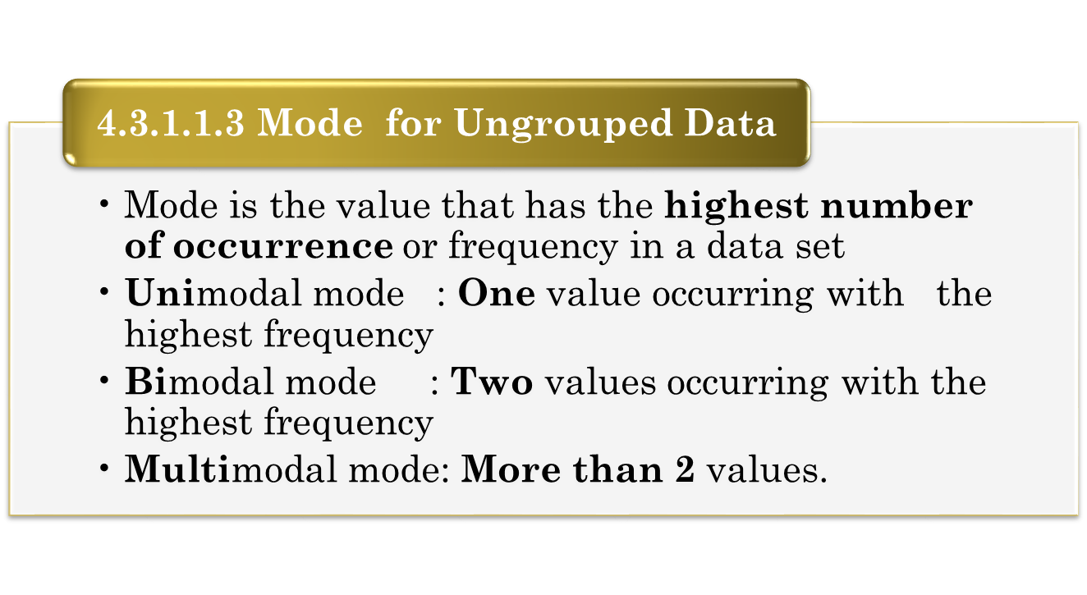
4.3.1 MEASURES OF CENTRAL TENDENCY
Example 3
Find the mode of the following data
1 2 6 2 1 2 7 5
Solution: 2

Slide 10
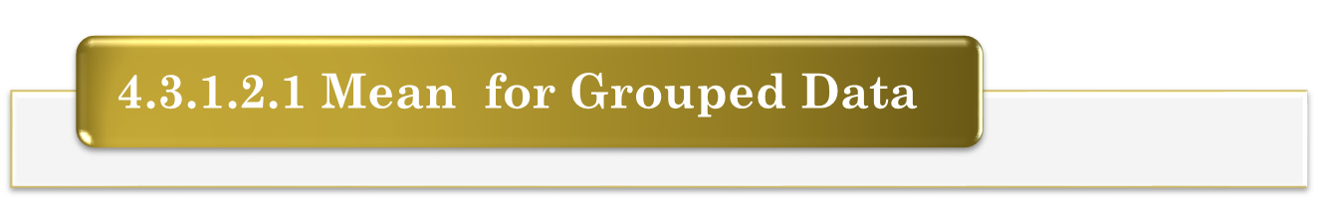
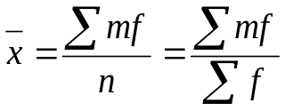
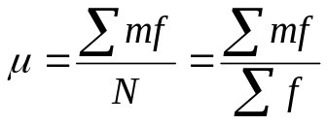
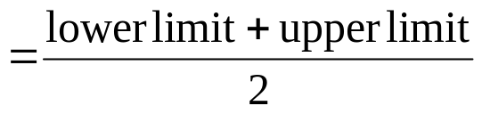

4.3.1 MEASURES OF CENTRAL TENDENCY
For Sample Data:
For Population Data:
where m= the midpoint of the class
total frequency of the class

Slide 11

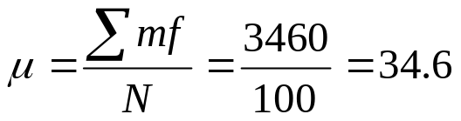
Example 4
The following table gives the frequency distribution of the
age of all 100 staffs in FCI, MMU.
Calculate the average age of all these 100 staffs.
Solution:
Age in years | Number of employees
20 to less than 30 | 45
30 to less than 40 | 24
40 to less than 50 | 21
50 to less than 60 | 10
Age in years | f | m | mf
20 - < 30 | 45 | 25 | 1125
30 - < 40 | 24 | 35 | 840
40 - < 50 | 21 | 45 | 945
50 - < 60 | 10 | 55 | 550
 | N=100

Slide 12
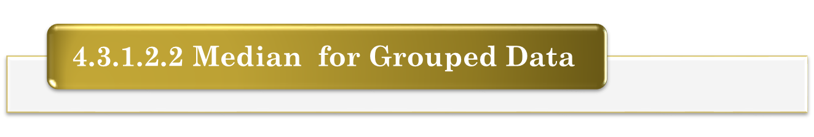
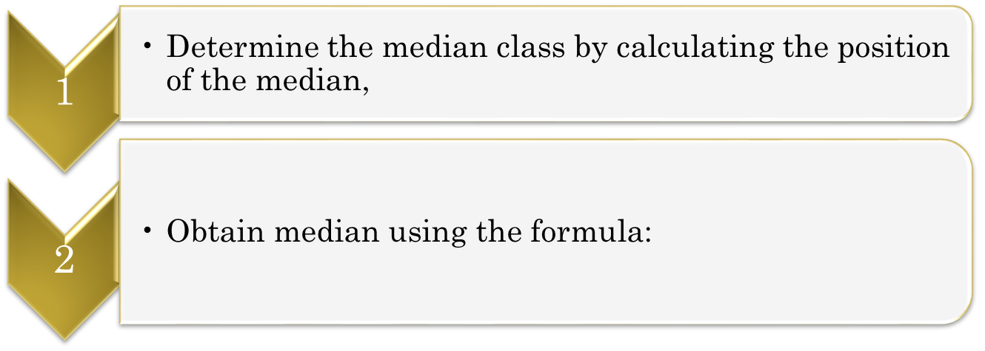
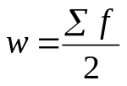
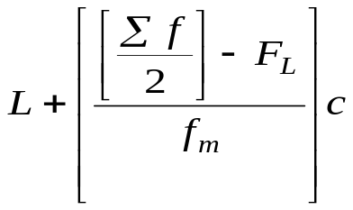



4.3.1 MEASURES OF CENTRAL TENDENCY
Steps:
where L = Lower boundary of median class
= Total frequencies
= Total frequencies for all classes before median class
= Frequency of median class
c = Class width of median class

Slide 13

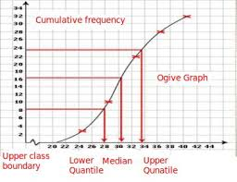
4.3.1 MEASURES OF CENTRAL TENDENCY
The median may also be estimated from an ogive.

Slide 14
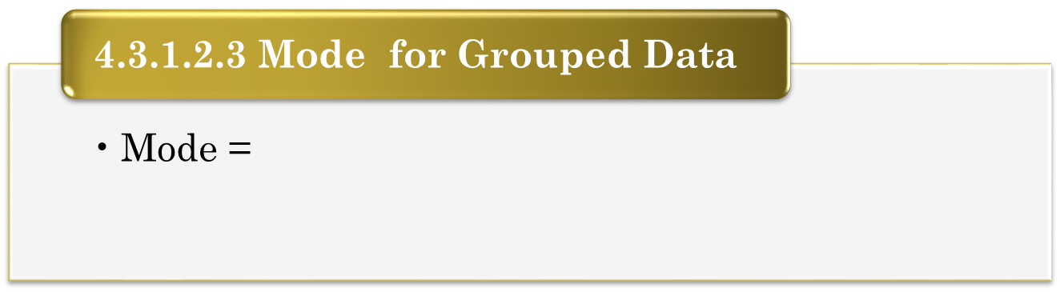
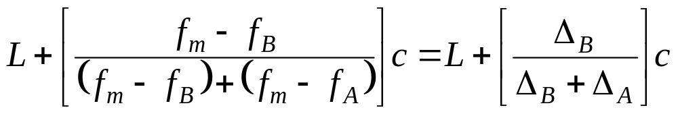



4.3.1 MEASURES OF CENTRAL TENDENCY
where
L = Lower boundary of the mode class
= Frequencies of the mode class
= Frequency of 1 class before the mode class
= Frequency of 1 class after the mode class
c = Class width of the mode class

Slide 15

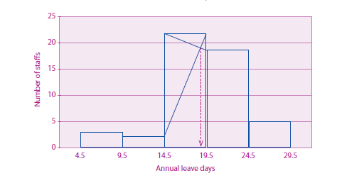
4.3.1 MEASURES OF CENTRAL TENDENCY
The mode may also be estimated from a histogram.

Slide 16
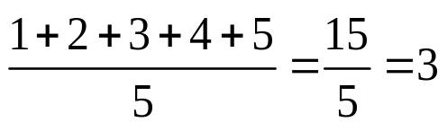
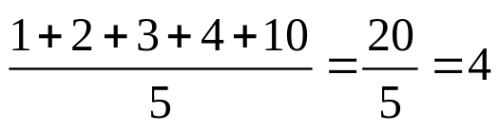
WHAT IS THE BEST MEASURE OF CENTRAL TENDENCY?
Consider this set of test score values:
The set on the left shows the actual scores. The set on the right shows what would happen if one of the scores was WAY out of range in regard to the other scores. Such a term is called an outlier.
With the outlier, the mean changed.
With the outlier, the median did NOT change.
The median is preferred in this situation as the value of the mean can be distorted by the
outliers. However, it will depend on how influential the outliers are. If they do not
significantly distort the mean then using the mean as the measure of central tendency will
usually be preferred because it includes every value in of the data set as part of the
calculation.
0 1 2 3 4 5 6 7 8 9 10
0 1 2 3 4 5 6 7 8 9 10
Mean = 3
Mean = 4

Slide 17
HOW DO I KNOW WHICH MEASURE OF CENTRAL TENDENCY TO USE?
MEAN
Use the mean to describe the middle of a set of data that does not have an outlier.
Advantages:
- Most popular measure in fields such as business, engineering and computer science.
- It is unique - there is only one answer.
- Useful when comparing sets of data.
Disadvantages:
- Affected by extreme values (outliers)
MEDIAN
Use the median to describe the middle of a set of data that does have an outlier.
Advantages:
- Extreme values (outliers) do not affect the median as strongly as they do the mean.
- Useful when comparing sets of data.
- It is unique - there is only one answer.
Disadvantages:
- Not as popular as mean.
MODE
Use the mode when the data is non-numeric or when asked to choose the most popular item.
Advantages:
- Extreme values (outliers) do not affect the mode.
Disadvantages:
- Not as popular as mean and median.
- Not necessarily unique - may be more than one answer
- When no values repeat in the data set, the mode is every value and is useless.
- When there is more than one mode, it is difficult to interpret and/or compare.

Slide 18
4.3.2 MEASURES OF DISPERSION
A measure of dispersion is a measure that tells us how the data is spread out, or dispersed about the mean.
There are three measures of the dispersion, which are:
range
variance
standard deviation

Slide 19
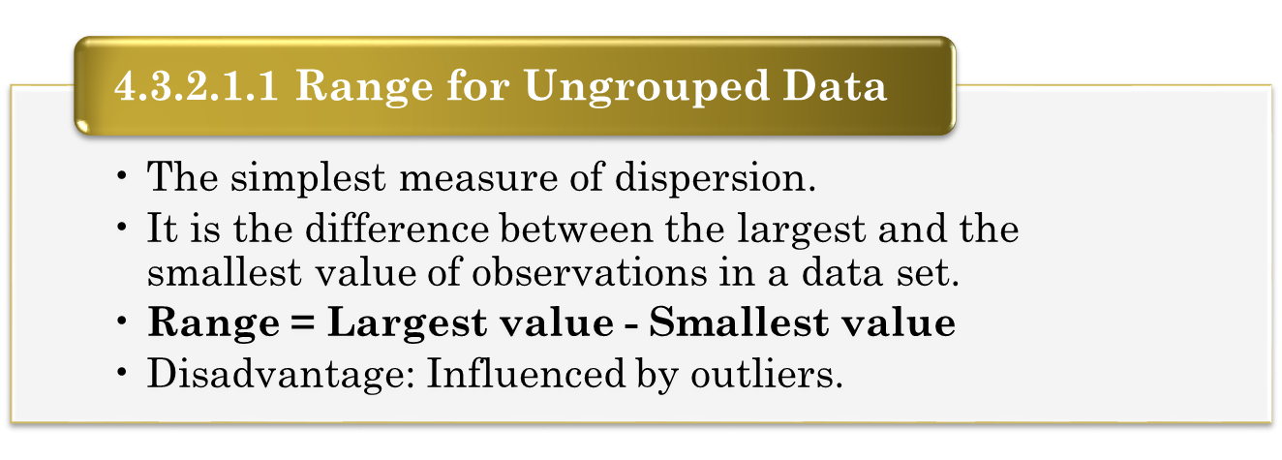
4.3.2 MEASURES OF DISPERSION

Slide 20
Example 5
The following data are the results of PMT0301 final examination for
6 students:
Students Exam marks
Kelvin 80
Fatimah 67
Jason 10
Teoh 57
Justin 92
Mimi 79
Solution:
From the given data,
the highest value is 92 and
the lowest value is 10.
Thus, range = 92-10 = 82.

Slide 21
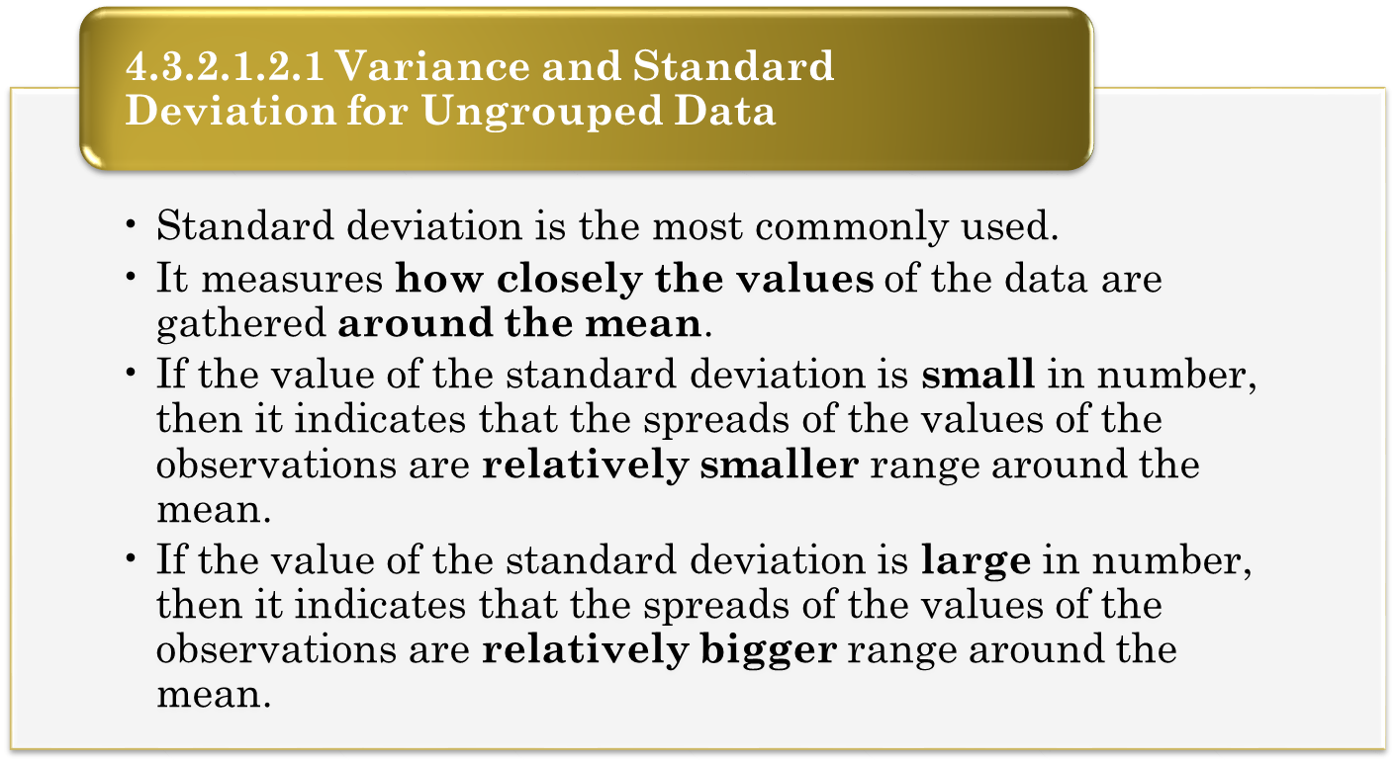
4.3.2 MEASURES OF DISPERSION

Slide 22
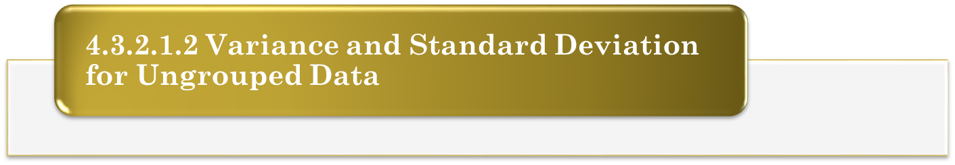
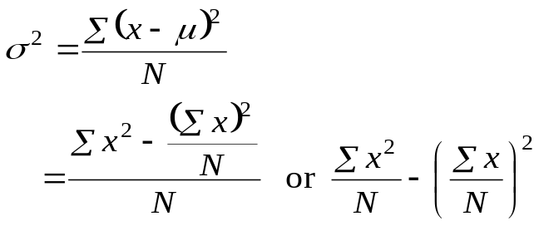
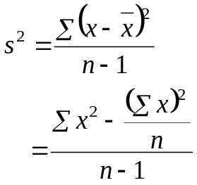


4.3.2 MEASURES OF DISPERSION
For Population Data For Sample Data
Variance, Variance,
Note:
☞ The population standard deviation
☞ The sample standard deviation
☞ Thus, the value of the standard deviation is never negative.

Slide 23

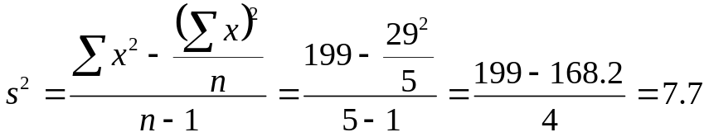



Example 6
The following data lists the numbers of hours spent per week by 5
randomly selected students to surf internet.
10 3 7 5 4
Calculate the variance and standard deviation for these data.
Solution:
Let x the numbers of hours spent per week to study Statistics course:
10 | 100
3 | 9
7 | 49
5 | 25
4 | 16

Slide 24
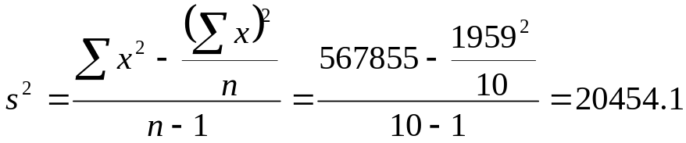



Example 7
Data below is the 2003 earnings (in millions of dollars) of ten
celebrities. Find the variance and standard deviation for these data.
Solution: Let x the earnings (in millions of dollars) of ten celebrities:
55 | 267 | 175 | 47 | 125
366 | 156 | 501 | 125 | 142
55 | 3025
366 | 133956
267 | 71289
156 | 24336
175 | 30625
501 | 251001
47 | 2209
125 | 15625
125 | 15625
142 | 20164

Slide 25
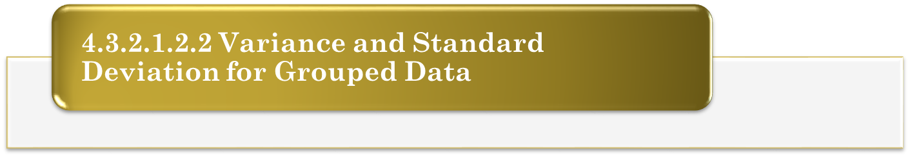
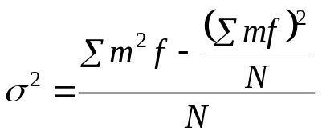
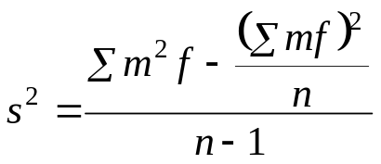


4.3.2 MEASURES OF DISPERSION
For Population Data For Sample Data
Variance, Variance,
Note:
☞ The population standard deviation
☞ The sample standard deviation
☞ Thus, the value of the standard deviation is never negative.

Slide 26



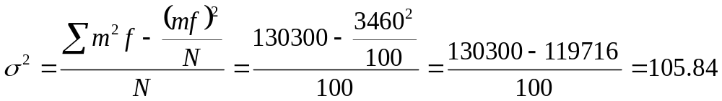

Example 8
The following table gives the frequency distribution of the age of all 100
lecturers in a college. Calculate the variance and standard deviation for
given data.
Solution:
Age in years | Number of employees
20 to less than 30 | 45
30 to less than 40 | 24
40 to less than 50 | 21
50 to less than 60 | 10
Age in yr. | F
20 - < 30 | 45 | 25 | 1125 | 625 | 28125
30 - < 40 | 24 | 35 | 840 | 1225 | 29400
40 - < 50 | 21 | 45 | 945 | 2025 | 42525
50 - < 60 | 10 | 55 | 550 | 3025 | 30250
Sum |  |  | 3460 |  | 130300

Slide 27
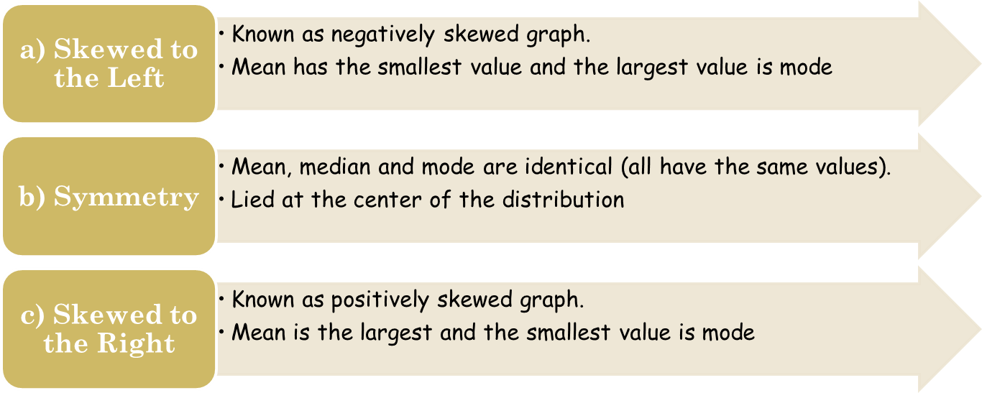
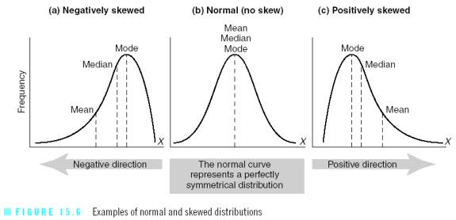
THE SHAPE OF THE DISTRIBUTION AND THE RELATIONSHIPS AMONG THE MEAN, MEDIAN AND MODE

